Slide 1
SnapDocc.
Photo of a list, receipt or table in. Excel, Word, PDF, CSV or TXT out. All inside WhatsApp.
Python, FastAPI, Twilio, Groq Qwen vision, OpenCV, Docker, Render
Notes:
Introduce yourself in one line. Then: "SnapDocc turns a photo into a file, right inside WhatsApp. I built it end to end: reading the image, the chat flow, the file generators and the deployment."

Slide 2
Paper data stays stuck on paper
THE PROBLEM
Slow
Handwriting
Structure
Shopping lists, bills and notes are retyped into Excel by hand.
Classic OCR is built for print. Cursive comes out as "Boo k".
Plain text loses rows and columns, so a table becomes a mess.
SnapDocc · 2
Notes:
Set the scene. Everyone has paper lists or bills. Typing is slow, and the usual free OCR tool (Tesseract) is made for printed text. On my own handwritten test photo it split "Book" into "Boo k". I wanted something a normal person can use from the app they already have open: WhatsApp.

Slide 3
One photo, three steps
THE SOLUTION
1
2
3
Send a photo
Edit first?
Get the file
On WhatsApp, from any phone. No app to install.
Yes: fix the text on a simple web page. No: just pick a format.
Excel, Word, PDF, CSV or TXT arrives in the same chat.
SnapDocc · 3
Notes:
Walk through the three steps as in the demo. The bot never asks the user to resend a photo; it always processes the first one. The "edit first" question exists because no OCR is perfect, so the user can correct it before the file is made.

Slide 4
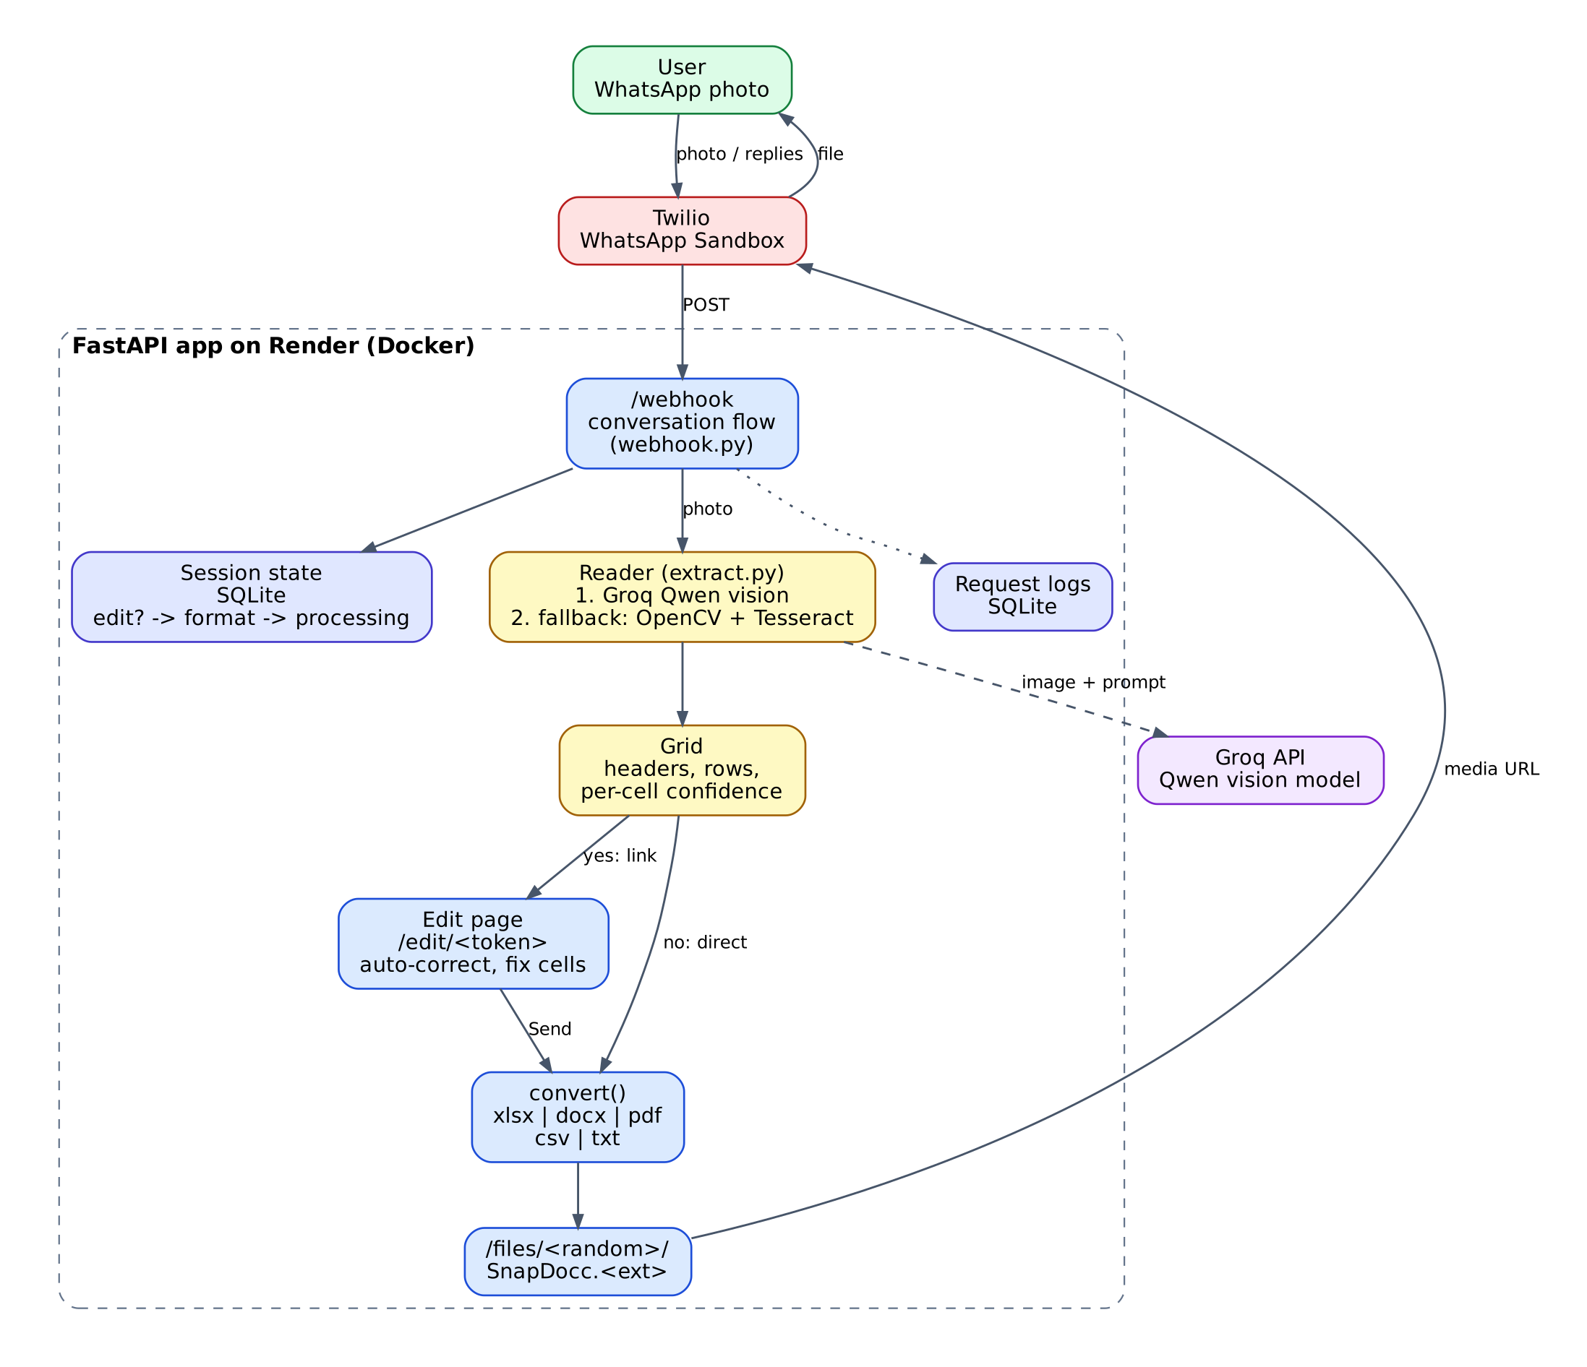
How it fits together
ARCHITECTURE
Twilio passes each WhatsApp message to my FastAPI webhook.
A reader turns the photo into a table with a confidence score per cell.
Generators build the file, and Twilio delivers it back to the chat.
SnapDocc · 4
Notes:
Follow the arrows top to bottom. The user sends a photo; Twilio calls my webhook on Render. The webhook keeps conversation state in SQLite. The reader asks Groq's Qwen vision model for a table, or falls back to OpenCV plus Tesseract. The result is a grid of headers, rows and per-cell confidence. Either the user edits it on the web page, or it goes straight to the file generators. The file is served from a random link and Twilio delivers it to WhatsApp.

Slide 5
Six small parts, one job each
MODULES
Module | What it does
ocr/ | Reads the photo: Qwen vision, Tesseract backup
structuring/ | Detects list or table, splits quantity / unit / item
webhook + session | Chat flow and session state with expiry
web.py | Edit page with spelling and grammar auto-correct
db + housekeeping | Request logs and cleanup of old photos and links
SnapDocc · 5
Notes:
Each folder in the project has one clear job, which keeps the code easy to test and explain. structuring/ is the original bounding-box logic from my OCR phase (it groups words into rows and columns). With the vision model the table comes back already structured, but this module still serves the Tesseract fallback.

Slide 6
Qwen first, Tesseract as backup
THE READER
Groq + Qwen vision
OpenCV + Tesseract
Reads the way a person does, using context for messy handwriting. Returns the table directly, plus the cells it is unsure about.
Automatic fallback if the AI call fails. Cleans the image, reads words with boxes and confidence, then groups them into rows.
Unsure cells are highlighted yellow, so you know what to double-check.
SnapDocc · 6
Notes:
Why a vision model: Tesseract matches character shapes; a vision model understands the page. On my handwritten test photo Tesseract returned "Boo k" and Qwen returned "Book". That is one photo, not a benchmark. If the AI call fails, the bot says so ("basic OCR, less accurate") instead of failing silently. That silent fallback once hid a retired model name from me, which is why the reason is now shown to the user.

Slide 7
Fix it before you get the file
THE SAFETY NET
Item
Qty
Rice
2 kg
Brown bread
1
Your photo sits next to the extracted table.
Unsure cells are yellow until you edit them.
One click corrects spelling and grammar.
Add or remove rows, pick a format, press Send.
The file comes back to your WhatsApp chat.
Milk
1 L
Send to my WhatsApp
Illustration, not real data. Yellow = low confidence.
SnapDocc · 7
Notes:
This is the part that makes the project honest about accuracy. No OCR is perfect, so instead of hiding mistakes, the bot shows which cells it is unsure about and lets the user fix them. The edit link is a random token that expires after 24 hours. The sample on the right is an illustration I made, not real output.

Slide 8
Built to handle other people's data
SAFETY AND CARE
Private links
Automatic cleanup
Random tokens for edit pages and file folders. Edit links expire after 24 hours.
Photos, files and old links are deleted on a schedule.
Safe spreadsheets
Input checks
Cells that start like a formula are neutralised in Excel and CSV.
5 MB image limit, invalid files rejected, sessions expire.
SnapDocc · 8
Notes:
A document photo can contain private things like bills, so I treated storage seriously even in a capstone. Formula injection: someone could write =HYPERLINK(...) in a note and it would run when opened in Excel, so cells that start with = + - or @ are made safe. Every request is also logged (time, document type, format, engine, confidence, processing time) for the logging requirement.

Slide 9
What it does not do yet
HONEST LIMITS AND NEXT STEPS
Limits today
Free Twilio sandbox: rejoin every 72 hours.
Render free tier sleeps and forgets files on restart.
No accuracy figure on real handwriting yet.
Very messy photos can still be misread.
Next steps
Benchmark on real handwritten photos.
Hindi and Marathi support.
Multi-page documents.
A real WhatsApp Business sender and a persistent database.
SnapDocc · 9
Notes:
Say the limits yourself before a recruiter finds them. The Twilio sandbox and Render free tier are limits of the free plans, not of the code. The most valuable next step is a proper benchmark on real handwritten photos, because my current CER/WER numbers use clean generated images.

Slide 10
THANK YOU
Send a photo to the bot and watch it turn into a file.
snapdocc-web-app.onrender.com
https://github.com/Aditya-Divekar/snapdocc_web_app
Notes:
Invite them to try it live. Remember to open the Render link first so the server is awake, and to rejoin the Twilio sandbox if it has been more than 3 days.

